Slide 1
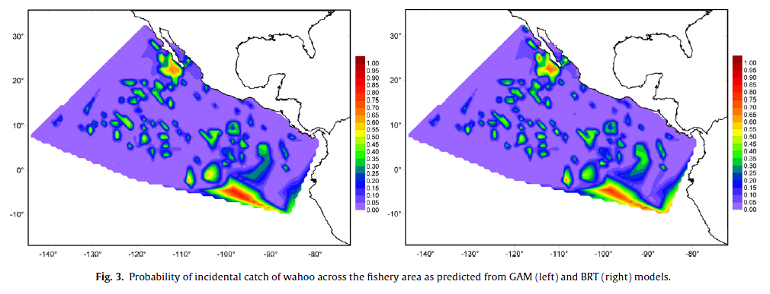
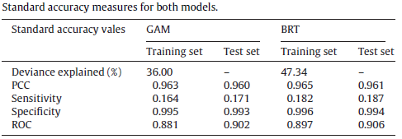
“Results indicate little difference between the performance of GAM and BRT models”
Best Possible Value
100%
1
1
0
1
Martinez-Rincon 2012, Comparative performance of generalized additive models and boosted regression trees for statistical modeling of incidental catch of wahoo (Acanthocybium solandri) in the Mexican tuna purse-seine fishery
Notes:
The BRT was made with over 5,000 trees!
deviance explained, percent correctly classified
(PCC), sensitivity (i.e., proportion of observed positives correctly
predicted), specificity (proportion of observed negatives correctly
predicted) and the area under the receiver operator characteristic
curve (ROC which gives a measure of the degree to which
fitted values discriminate between observed values)

Slide 2
Response Curves (partial)
GAMs
BRTs

